Slide 1
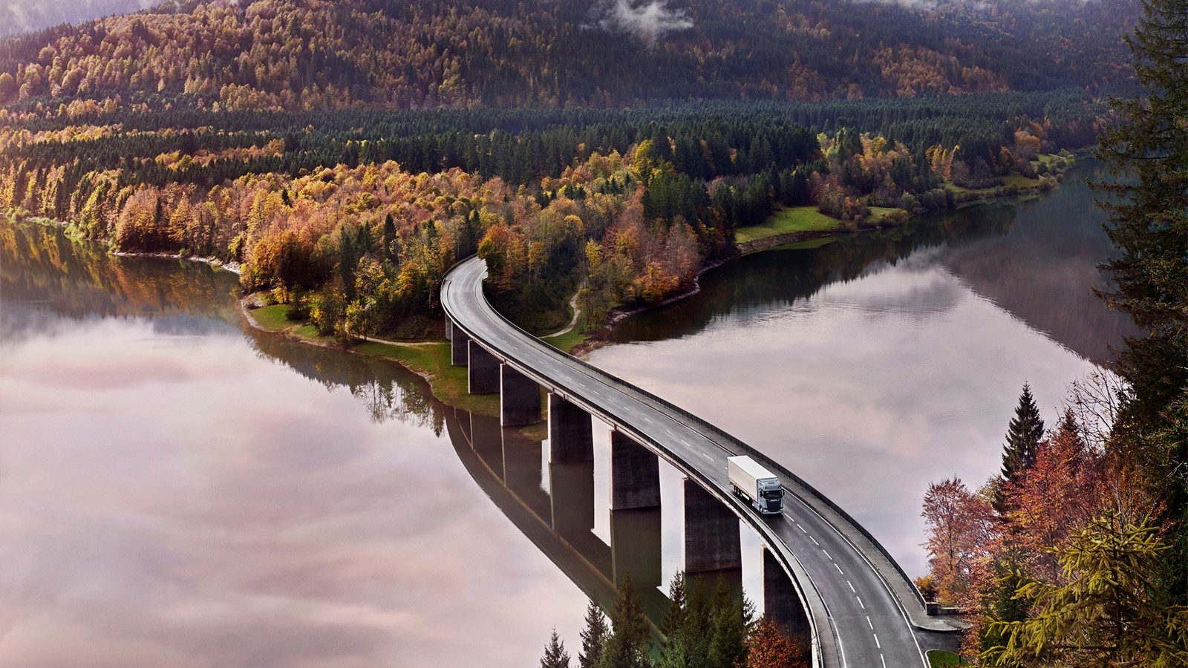

sustainability, climate and just Transition
MiCHAEL LYNGSIE
LISA OSBÄCK

Slide 2
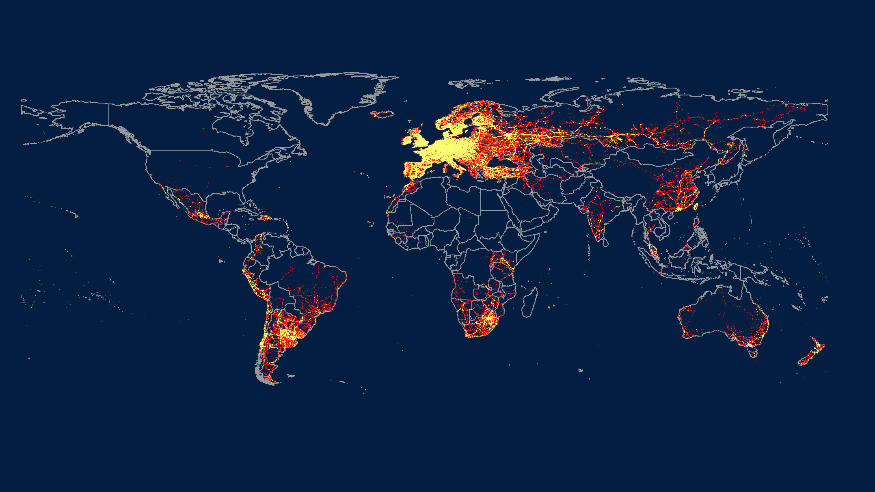
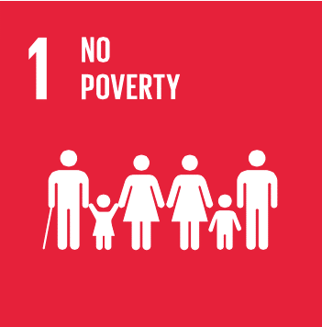





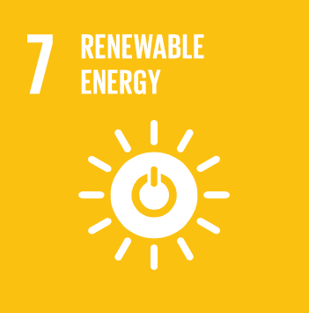


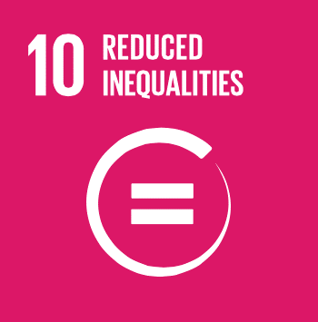

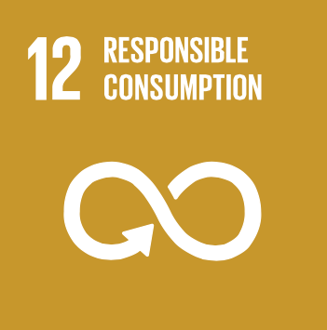


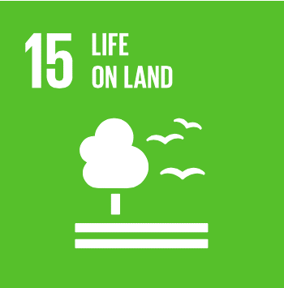

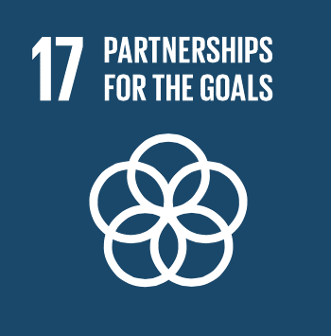

Slide 3
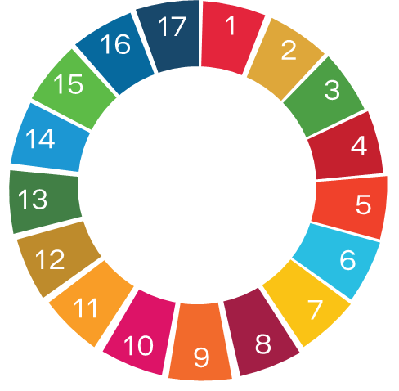
strategic sustainability approach
People Sustainability:
People Sustainability is about putting people and society at the centre of everything we do.
Scania’s Impact
circular business:
aligns with our core value, elimination of waste, as well as our lean production system and our modularisation approach.
decarbonisation:
Our main environmental impact and the are where be can make the biggest contribution to sustainable development.

Slide 4
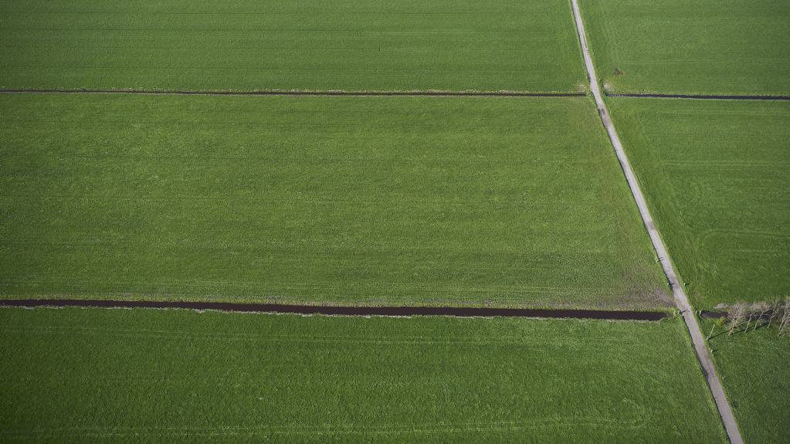
Sustainability at Scania
Renewable fuels and electrification
Sustainable Transport
Energy
efficiency
Smart
and safe
transport
Doing the right things
Diversity and
inclusion
Human
and labour
rights
Community
engagement
RESPONSIBLE BUSINESS
Environmental
footprint
Health and
safety
Business
ethics
Doing things right

Slide 5
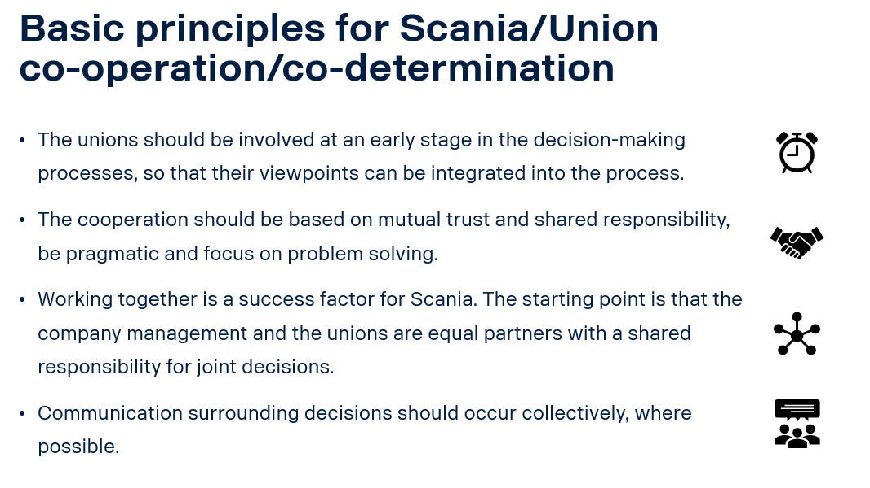
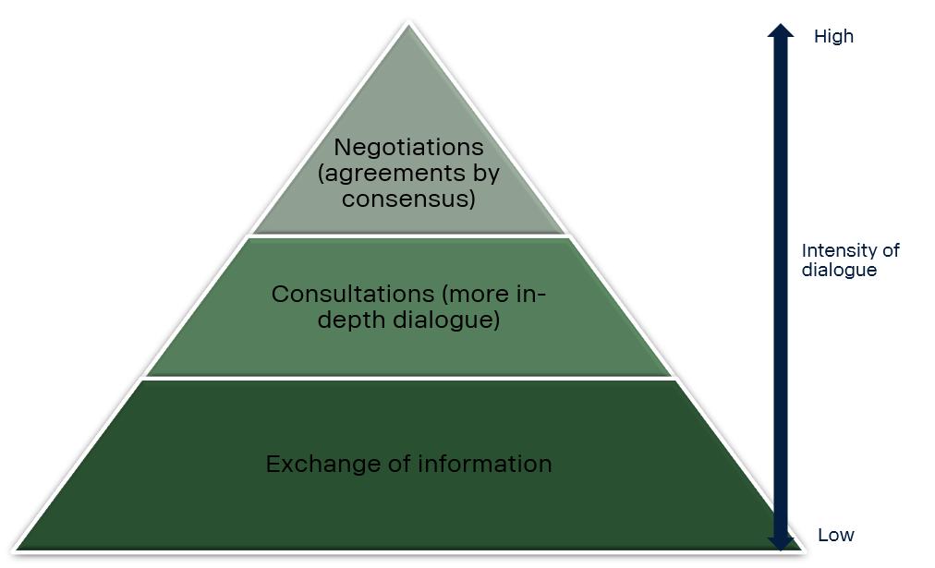
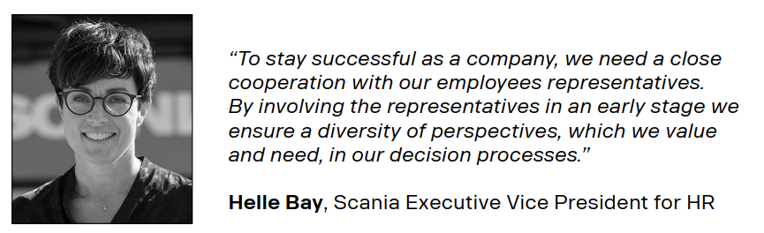
social dialogue
Scania has a long history of using social dialogue to reach better results
The Global labour relations principles and improvement program is about to be rolled out globally
We believe that meaningful social dialogue and equality are key to a just transition, and our engagement with the Global Deal initiative reflects this belief

